Slide 1
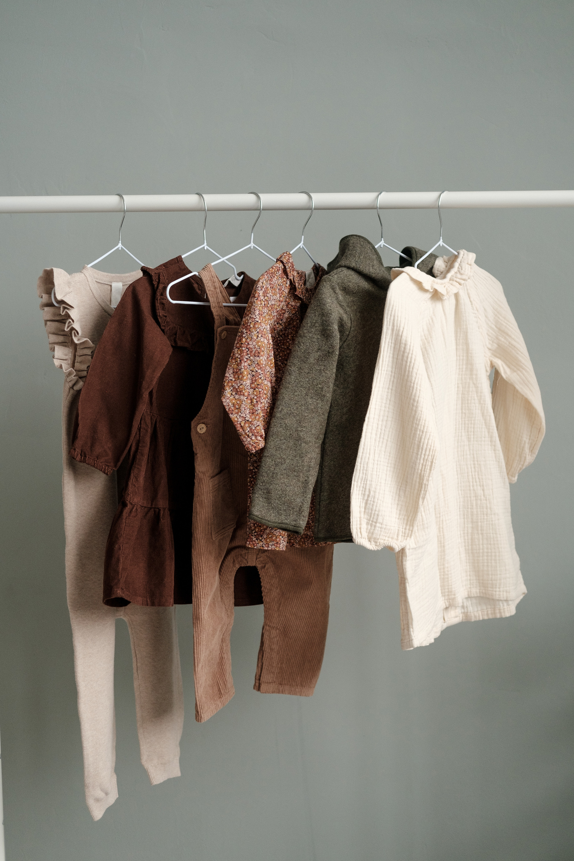
SNOOZE
AI Powered Fashion Discovery Platform

Slide 2
INTRODUCTION
AI-powered. Intuitively personalized. Effortlessly focused.
Discover exactly what you’re looking for—no more, no less.
Snooze is the next-gen AI search engine designed to eliminate doom scrolling and product overload.
Whether you're looking for a specific style, or vibe—Snooze filters the noise and brings you only what matters.
Say goodbye to irrelevant results and endless browsing.
Your perfect product match? Just one smart search away.

Slide 3
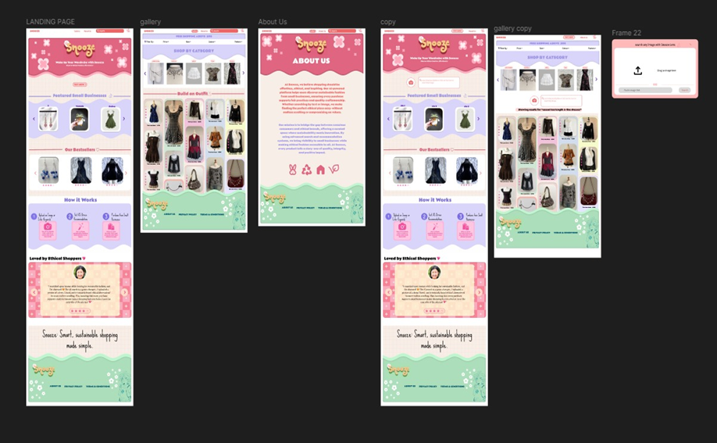
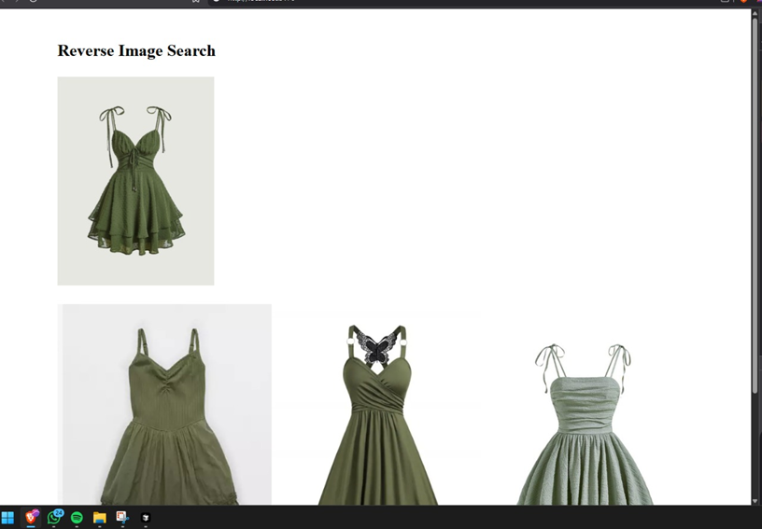
SNIPPETS

Slide 4
Problems
Makes search feel intuitive, not exhausting
Helps you shop intentionally, not impulsively
Filters out irrelevant noise and clutter
Ends doom-scrolling with smart, direct matches
Surfaces only what you’re really looking for
Connects you to curated results—fast and focused

Slide 5
TARGET AUDIENCE
Aged 20–35, urban, digitally savvy
Want fast, accurate, style-driven recommendations
01
03
Tired of endless browsing and irrelevant results
Care about saving time while still discovering great finds
02
04
Value personalization over generic options
Seek fashion that matches both their lifestyle and intent
05
06

Slide 6
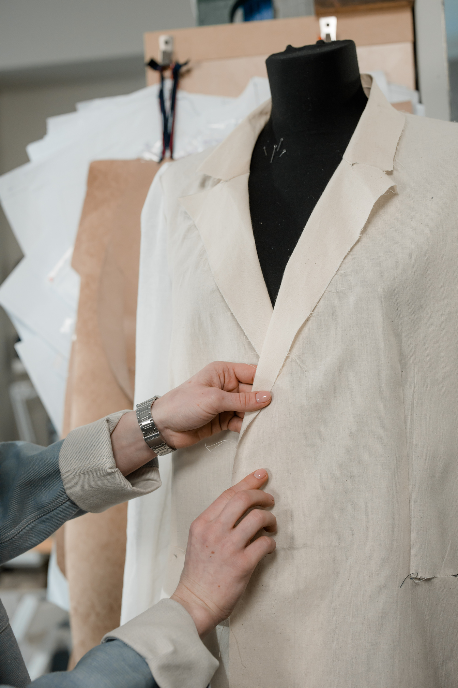
CONTRIBUITON
KEYS
Shows only what the user is actually searching for.
Uses intelligent filters to remove distractions.
BENEFITS
Faster, more relevant product discovery
Minimizes doom scrolling, maximizes intention

Slide 7
TECH STACK AND
RESOURCES
FRONTEND
React, JS, CSS, HTML
BACKEND
Python, flask , torch
AI & ML
ResNet50 (pre-trained) – image embeddings for visual similarity
Sentence Transformers – semantic search from text queries
Custom Filters – gender- and item-specific query refinement
STORAGE
CSV/Excel Files – local dataset handling
Image URLs – loaded on-the-fly, no separate storage needed

Slide 8
CONCLUSION
Empowers users to make ethical fashion choices
Bridges the gap between technology and sustainability
Future scope: Expand to more platforms and personalized AI
Join us in shaping a conscious shopping experience

Slide 9
Thank You
Presentation by:
Sowmya Negi (E23CSEU1102)
Aarushi Goel (E23CSEU1097)
Nandini Jaiswal (E23CSEU1083)

